Slide 1
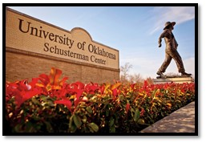
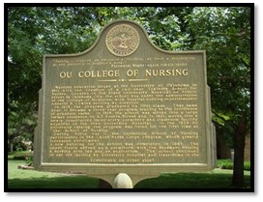

Slide 2
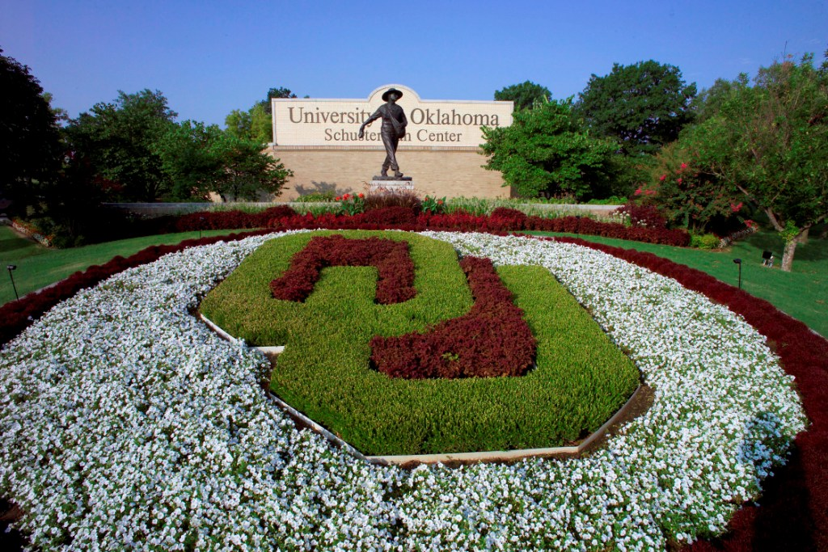

Slide 3
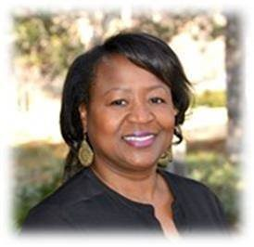
Dr. Judy Ogans
Assistant Dean of Student Affairs

Slide 4
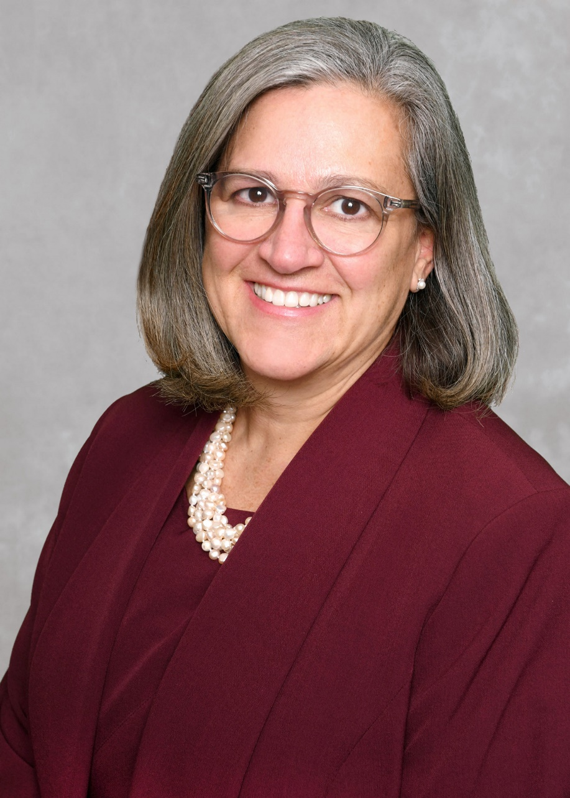
Dr. Julie Hoff
Dean, College of Nursing

Slide 6
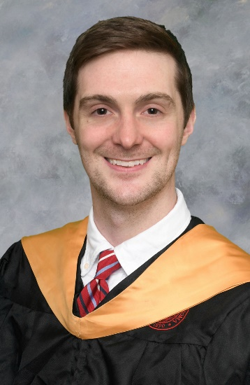
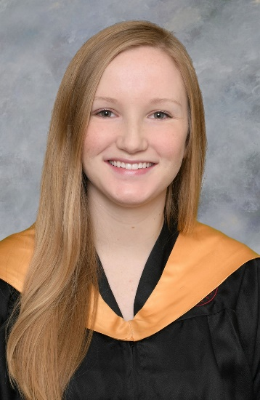
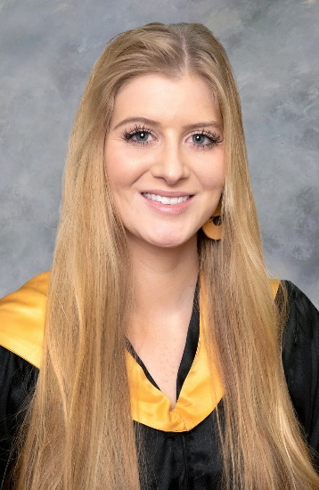
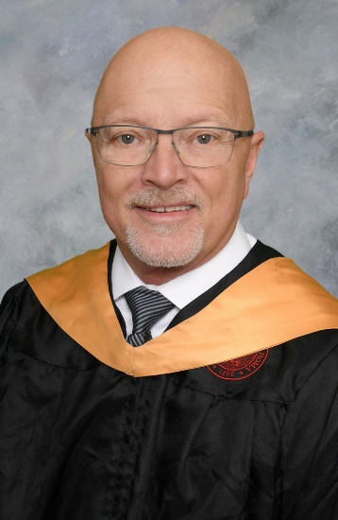
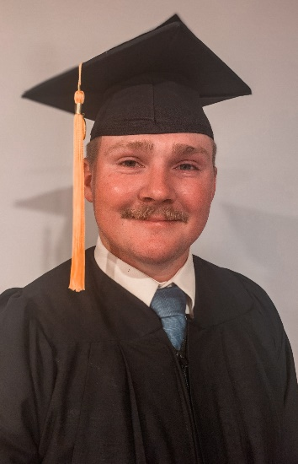
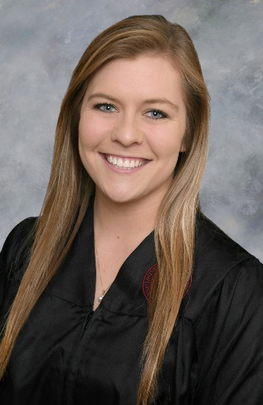
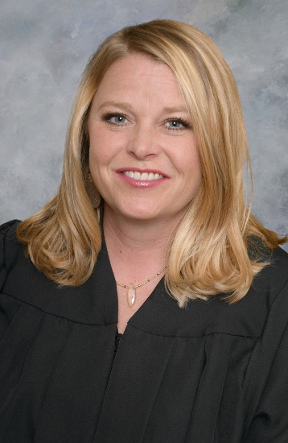
College of Nursing Student Association Officers
Peter Guzman
President
Margaret Bennett
Vice-President
Channah Moore
Secretary
Stephen Barry
Treasurer
Kory Kemp
Community Outreach
Brooke Streater
Social Chair
Katie Pitt
Apparel Chair

Slide 7
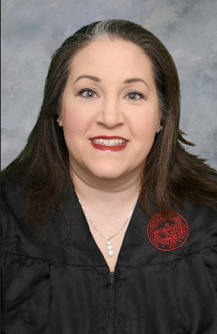
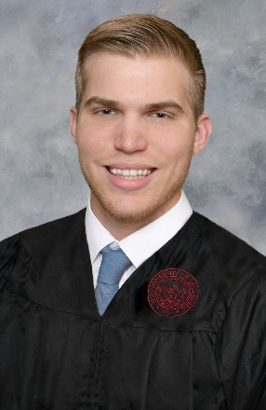
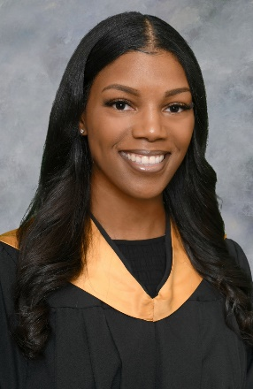
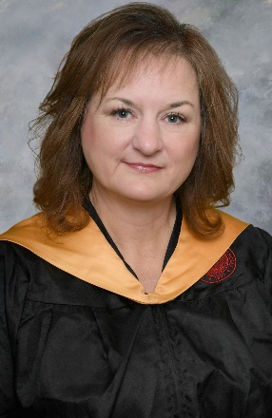
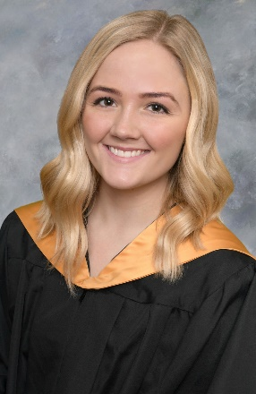
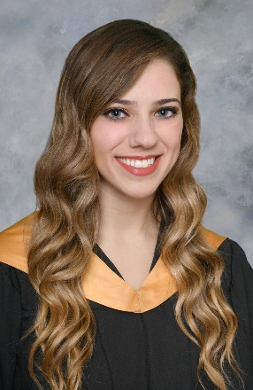
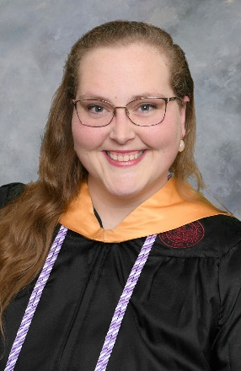
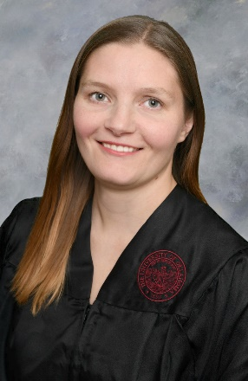
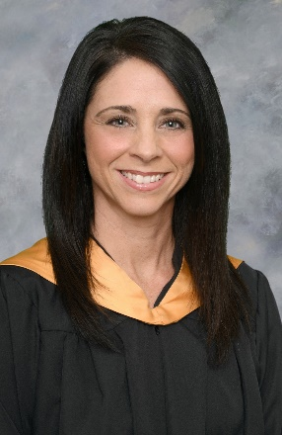
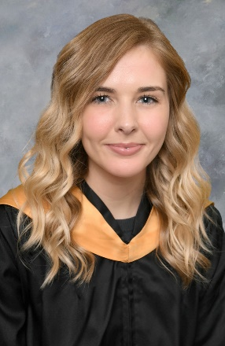
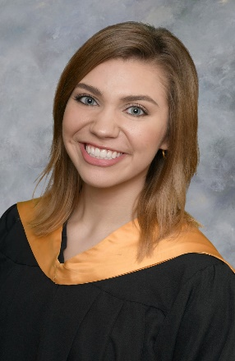
OU Student Nurses’ Association Officers
Whitney Parker
President
Steven Dittmer
Vice-President
Brittany Hill
Secretary
Stephen Barry
Treasurer
Cheryl McGuire-Howard
Membership Director
Cantlin Simpler
Community Service
Jonni Nigro
Public Relations
Ashley O’Banion
Historian
Jillian Myers
Hospitality Chair
Amanda Burch
OUTSGA Representative
Cheyenne Colby
Co-CPR Chair
Alyxandra Sestak
Co-CPR Chair

Slide 8
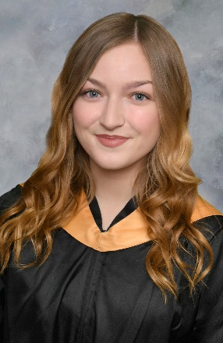
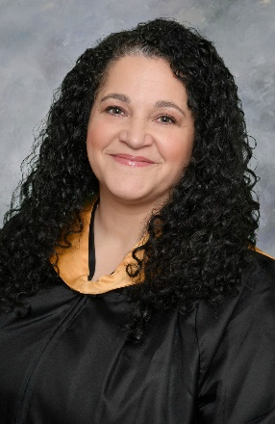
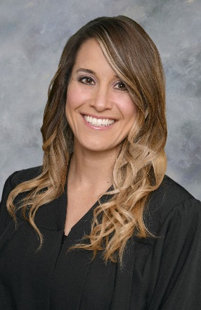
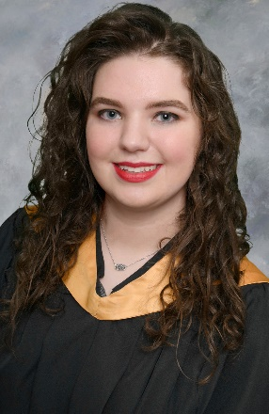
OUSNA CPR Instructors
Margaret Bennett
Amanda
Burch
Cheyenne Colby
Daelyn
Dewitt
Sonja
Johnson
Cheryl
McGuire-Howard
Rachel
Metcalf-Jacoby
Whitney
Parker
Alyxandra
Sestak
Cantlin
Simpler
Nicole
Sowards

Slide 10
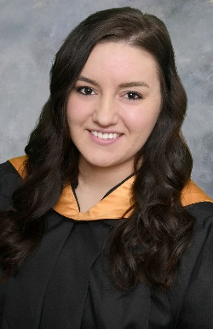
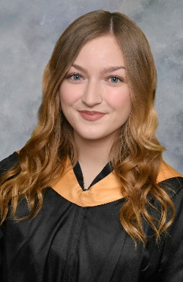
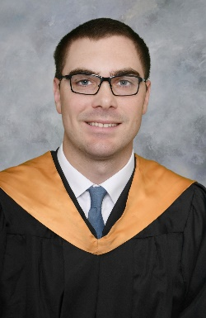
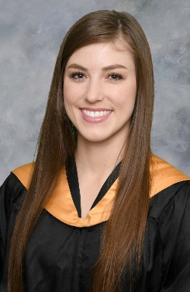
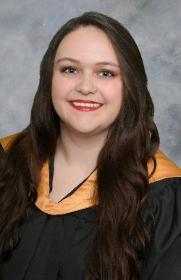
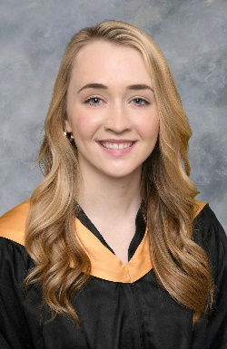
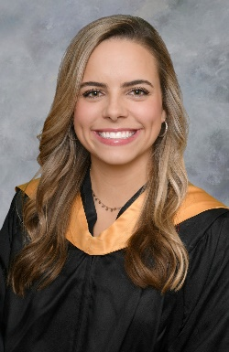
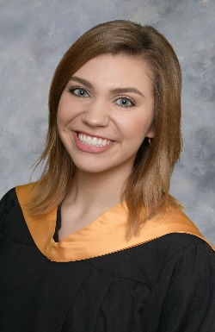
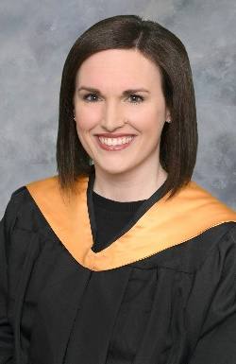
Sigma Theta Tau Inductees
Nursing Honor Society

Slide 11
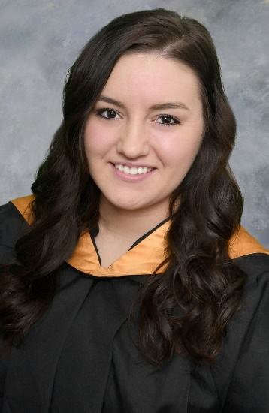
Special Distinction
BSN
Hannah
Allison
Daelyn
DeWitt
Justin
Farrar
Nicole
Sowards
Teagan
Jackson
Peyton
King

Slide 12
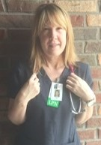
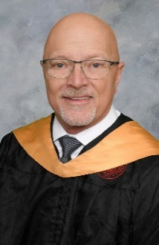
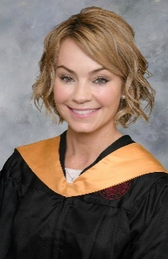
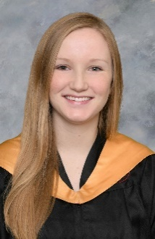
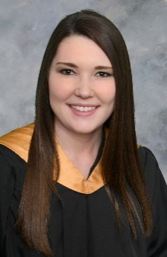
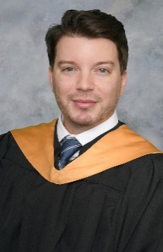
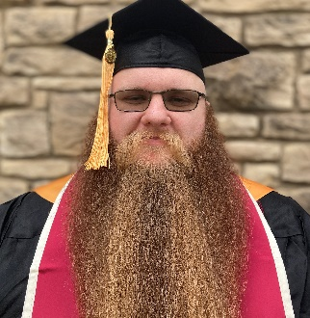
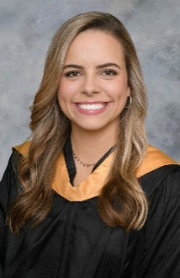
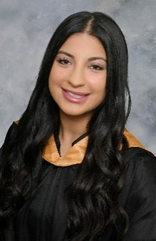
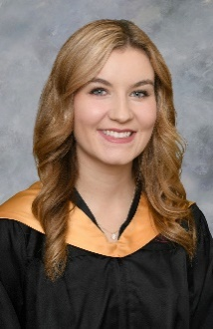
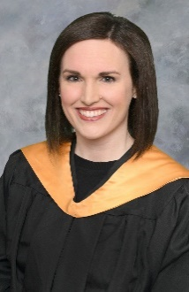
Shelley Autrey Stephen Barry Anna Bartlett Margaret Bennett Shaina Benson Cheyenne Colby John Gibbens Peter Guzman Mylee Hewitt
Distinction
BSN
Brittany Hill Jarrett Johnson Sonja Johnson Cheryl McGuire-Howard
Emily Moran Jonni Nigro Leilah Salazar-Khalid Alyxandra Sestak Cantlin Simpler Elizabeth Stevens Ashley Weeks

Slide 13
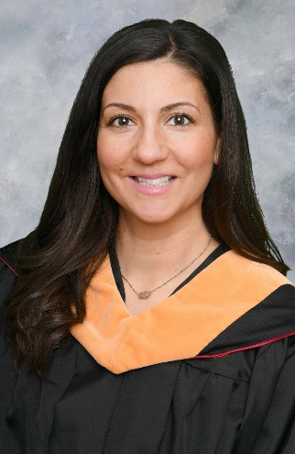
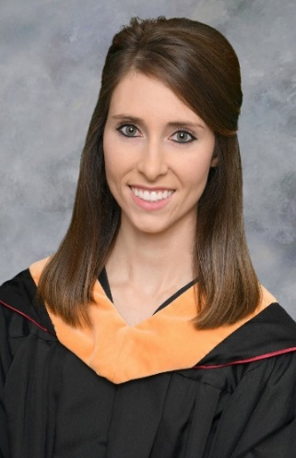
Special Distinction
MSN
Cristina Barnes
Kelsey Brittingham
Vanessa Brown
Mary Chelf
Kallie Garrett
Julie Kelly
Aimee Kehres
Janae Miller
Rachel Shields
Julie Vacin

Slide 14
“I’ve learned that people will
forget what you said, people will
forget what you did, but people
will never forget how you made
them feel.”
Maya Angelou

Slide 15
Clinical Nursing Practice
Award
Traditional Program
John
Gibbens
Sonja
Johnson
Peter
Guzman
Ashley
Weeks
Brittany
Hill
Kory
Kemp

Slide 16
Clinical Nursing Practice
Award
Degree Completion Program
Shaina
Benson
Krystal
Roth
Aaron
Boggs

Slide 17
Outstanding Professional Service
Award
Traditional Program
Amanda
Burch
Cheryl
McGuire-Howard
Kory
Kemp

Slide 18
Leadership Award
Traditional Program
Stephen
Barry
Alyxandra
Sestak

Slide 19
Leadership Award
Degree Completion Programs
Kelsey
Hancock

Slide 20
Clinical Nursing Practice
Award
MSN
Sheryl
Klenovich

Slide 21
Outstanding Professional Service
Award
MSN
Brianna
Reyes

Slide 22
Excellence in Research
Award
MSN
Bethany
Smith

Slide 23
“Success is peace of mind in
knowing that you did your best
to become the best that you are
capable of becoming. “
John Wooden

Slide 24
Outstanding Student
Traditional Program
Kory Kemp

Slide 25
Outstanding Student
Degree Completion Programs
Shaina Benson

Slide 27
Master
of
Science in Nursing
Candidates

Slide 28
Cristina Barnes
Family Nurse Practitioner

Slide 29
Kelsey Brittingham
Family Nurse Practitioner

Slide 30
Vanessa Brown
Family Nurse Practitioner

Slide 31
Tammie Caves
Administration Management

Slide 32
Mary Chelf
Family Nurse Practitioner

Slide 33
Kallie Garrett
Clinical Nurse Specialist

Slide 34
Lora Beth Horton
Family Nurse Practitioner

Slide 35
Aimee Kehres
Family Nurse Practitioner

Slide 36
Julie Kelly
Family Nurse Practitioner

Slide 37
Sheryl Klenovich
Education

Slide 38
Janae Miller
Family Nurse Practitioner

Slide 39
Christine Munoz
Family Nurse Practitioner

Slide 40
Michael Porter
Administration Management

Slide 41
Brianna Reyes
Family Nurse Practitioner

Slide 42
Susan Roberts
Family Nurse Practitioner

Slide 43
Itzel Daniela Romo
Family Nurse Practitioner

Slide 44
Taylor Russell
Family Nurse Practitioner

Slide 45
Rachel Shields
Administration Management

Slide 46
Bethany Smith
Education

Slide 47
Julie Vacin
Administration Management

Slide 48
Bachelor
of
Science in Nursing
Candidates

Slide 50
Hannah Allison

Slide 51
Shelley Autrey

Slide 52
Julieth Barlow

Slide 53
Stephen Barry

Slide 54
Anna Bartlett

Slide 55
Margaret Bennett

Slide 56
Shaina Benson

Slide 57
Adrian Bernal

Slide 58
Aaron Boggs

Slide 59
Amanda Burch

Slide 60
Tyler Chanley

Slide 61
Brawna Chowins

Slide 62
Glory Christian

Slide 63
Cheyenne Colby

Slide 64
Daelyn DeWitt

Slide 65
Steven Dittmer

Slide 66
Callee Donaho-Moore

Slide 67
Justin Farrar

Slide 68
Madeline Gaffney

Slide 69
Joshua Garrison

Slide 70
John Gibbens

Slide 71
Peter Guzman

Slide 72
Kelsey Hancock

Slide 73
Mylee Hewitt

Slide 74
Cheyenne Higgins

Slide 75
Shawnte’ Hildebrandt

Slide 76
Brittany Hill

Slide 77
Brian Hixson

Slide 78
Dillon Hyden

Slide 79
Teagan Jackson

Slide 80
Brenda Johnson

Slide 81
Jarrett Johnson

Slide 82
Sonja Johnson

Slide 83
Whitney Johnson

Slide 84
Kory Kemp

Slide 85
Ariel Kidwell

Slide 86
Peyton King

Slide 87
Brittny Lowery

Slide 88
Cheryl McGuire-Howard

Slide 89
Rachel Metcalf-Jacoby

Slide 90
Channah Moore

Slide 91
Emily Moran

Slide 92
Jillian Myers

Slide 93
Jonni Nigro

Slide 94
Ashley O’Banion

Slide 95
Whitney Parker

Slide 96
Shayla Pickett

Slide 97
Katie Pitt

Slide 98
Krystal Roth

Slide 99
Leilah Salazar-Khaled

Slide 100
Alyxandra Sestak

Slide 101
Cantlin Simpler

Slide 102
Nicole Sowards

Slide 103
Elizabeth Stevens

Slide 104
Brooke Streater

Slide 105
Hannah Vaughn

Slide 106
Ashley Weeks

Slide 107
Britt Williams

Slide 108
OU College of Nursing Pledge
I solemnly pledge myself, in the presence of this assembly, to practice my profession faithfully.
I will endeavor to be a role model, educator, and advocate of health, safety, and wellness.
I will care for myself and others in mind, body, and spirit.

Slide 109
I will not take or knowingly administer any harmful drug or substance.
I will do all in my power to maintain and elevate the standard of my profession.
I will hold in confidence all personal matters committed to my keeping and all family affairs coming to my knowledge in my practice.

Slide 110
With loyalty, I will endeavor to collaborate with the interdisciplinary team.
I will devote myself to my personal welfare, to those committed to my care and to my community.

Slide 112
OU Chant
O-K-L-A-H-O-M-A
Our chant rolls on and on!
Thousands strong
Join heart and song
In alma mater’s praise
Of campus beautiful by day and night
Of colors proudly gleaming Red and White
‘Neath a western sky
OU’s chant will never die.
Live on University!

Slide 113
Congratulations, Graduates!
BOOMER SOONER

